Slide 1
INDEX
서브 쿼리
특수 쿼리
테이블의 결합 (합집합, 차집합)

Slide 2
서브 쿼리
서브 쿼리의 종류
서브쿼리가 사용 될 수 있는 SQL 문

Slide 3
1. 서브 쿼리(Subquery)의 종류(1/3)
단일행 서브 쿼리
한 개의 행으로 결과값이 반환되는 서브 쿼리
- 단일행 단일칼럼 경우
주로 SELECT 절, FROM 절 과 WHERE 절에서 사용 가능
SELECT FIRST_NAME, (SELECT MAX(SALARY) FROM JOBS)
FROM EMPLOYEES
WHERE SALARY > (SELECT AVG(SALARY) FROM EMPLOYEES);
- 단일행 다중칼럼 경우
FROM절과 WHERE 절에서 사용가능, SELECT 절 사용 불가
SELECT FIRST_NAME, SALARY
FROM EMPLOYEES
WHERE (SALARY, JOB_ID) = (SELECT SALARY, JOB_ID
FROM EMPLOYEES WHERE EMPLOYEE_ID = 101);
※ 반드시 단일 행이 되는 조건을 기억하자

Slide 4
--단일행 서버쿼리
--평균 SALARY 구하기
SELECT SUM(SALARY), COUNT(*)
FROM EMPLOYEES;
SELECT EMPLOYEE_ID, FIRST_NAME, JOB_ID, 691416 / 107 AS AVG
FROM EMPLOYEES;
SELECT *
FROM EMPLOYEES;

Slide 5
--새로운 데이터 입력
INSERT INTO EMPLOYEES (EMPLOYEE_ID, FIRST_NAME, LAST_NAME,
EMAIL, PHONE_NUMBER, HIRE_DATE,
JOB_ID, SALARY,
MANAGER_ID, DEPARTMENT_ID)
VALUES ( 999, 'TaeHo', 'Lee',
'SAAKHAN', '555.555.555', TO_DATE('20131101', 'YYYYMMDD'),
'IT_PROG', 12000,
102, 60);

Slide 6
--계속적으로 평균값을 구할 수 있는 쿼리
SELECT EMPLOYEE_ID, FIRST_NAME, JOB_ID, SALARY,
(SELECT SUM(SALARY) FROM EMPLOYEES) AS SUM,
(SELECT COUNT(*) FROM EMPLOYEES) AS CNT,
(SELECT SUM(SALARY) FROM EMPLOYEES)
/ (SELECT COUNT(*) FROM EMPLOYEES) AS AVG
FROM EMPLOYEES;

Slide 7
SELECT EMPLOYEE_ID, FIRST_NAME, JOB_ID, SALARY
FROM EMPLOYEES
WHERE SALARY > (SELECT AVG(SALARY) FROM EMPLOYEES);
--평균 값보다 큰 데이터만 출력
--ERROR (SELECT 절 사용 불가의 경우)
--single-row subquery returns more than one row
--(단일 행 하위 질의에 2개 이상의 행이 리턴 되었습니다)
SELECT EMPLOYEE_ID, FIRST_NAME, JOB_ID, (SELECT SALARY FROM EMPLOYEES)
FROM EMPLOYEES;
-- 이 문제를 해결하기 위해서 다음과 같은 3가지 방법이 있음

Slide 8
--단일 행이 되는 조건
--1단일그룹함수 사용.
SELECT EMPLOYEE_ID, FIRST_NAME, JOB_ID,
(SELECT MAX(SALARY) FROM EMPLOYEES)
FROM EMPLOYEES;
--2.PK를 조건으로 사용
SELECT EMPLOYEE_ID, FIRST_NAME, JOB_ID,
(SELECT SALARY FROM EMPLOYEES WHERE EMPLOYEE_ID = 101)
FROM EMPLOYEES;
--3.ROWNUM = 1을 조건으로 사용(ROWNUM은 임의의 컬럼)
SELECT EMPLOYEE_ID, FIRST_NAME, JOB_ID,
(SELECT SALARY FROM EMPLOYEES WHERE ROWNUM = 1)
FROM EMPLOYEES;

Slide 9
--단일 행 다중 컬럼(SELECT문에서 사용 못함)
SELECT EMPLOYEE_ID, START_DATE, END_DATE, JOB_ID, DEPARTMENT_ID
FROM JOB_HISTORY
WHERE (EMPLOYEE_ID, START_DATE) = (SELECT EMPLOYEE_ID, HIRE_DATE FROM EMPLOYEES
WHERE EMPLOYEE_ID = 102);
--오류
SELECT EMPLOYEE_ID, FIRST_NAME, JOB_ID, (SELECT EMPLOYEE_ID, HIRE_DATE FROM EMPLOYEES
WHERE EMPLOYEE_ID = 102)
FROM EMPLOYEES;

Slide 10
1. 서브 쿼리(Subquery)의 종류(2/3)
다중행 서브 쿼리
둘 이상의 행이 결과값으로 반환되는 서브 쿼리
- 다중행 단일칼럼 경우
FROM절 과 WHERE 절에서 사용가능
SELECT FIRST_NAME, SALARY
FROM EMPLOYEES
WHERE JOB_ID IN (SELECT JOB_ID FROM JOBS);
- 다중행 다중칼럼 경우
FROM절 과 WHERE 절에서 사용가능
FROM절에서 테이블 대신으로 사용될때 인라인뷰라 한다
SELECT FIRST_NAME, SALARY
FROM EMPLOYEES
WHERE (SALARY, JOB_ID) IN (SELECT SALARY, JOB_ID
FROM EMPLOYEES WHERE JOB_ID = 'IT_PROG');

Slide 11
--다중 행 서브쿼리
SELECT FIRST_NAME, SALARY
FROM EMPLOYEES
WHERE JOB_ID IN (SELECT JOB_ID FROM JOBS);
SELECT FIRST_NAME, SALARY
FROM EMPLOYEES
WHERE JOB_ID = ANY (SELECT JOB_ID FROM JOBS);

Slide 12
SELECT EMPLOYEE_ID, START_DATE, END_DATE, JOB_ID,
DEPARTMENT_ID
FROM JOB_HISTORY
WHERE (EMPLOYEE_ID, START_DATE) IN (SELECT EMPLOYEE_ID, HIRE_DATE FROM EMPLOYEES);
SELECT A.EMPLOYEE_ID, A.FIRST_NAME, A.JOB_ID, B.SAL_SUM
FROM EMPLOYEES A,
(SELECT JOB_ID, SUM(SALARY) AS SAL_SUM FROM EMPLOYEES
GROUP BY JOB_ID) B
WHERE A.JOB_ID = B.JOB_ID;
-- (SELECT JOB_ID, SUM(SALARY) AS SAL_SUM FROM EMPLOYEES
GROUP BY JOB_ID) 이 부분이 인라인 뷰

Slide 13
1. 서브 쿼리(Subquery)의 종류(3/3)
상관 관계 서브 쿼리 – 사용상 주의!!
내부(서브쿼리)와 외부(메인쿼리)가 서로 관계를 맺는
서브 쿼리
- 외부 쿼리에서 행 하나당 내부 쿼리가 한번씩 실행
SELECT 절과 WHERE 절에서 사용가능
SELECT FIRST_NAME, SALARY, (SELECT AVG(SALARY) FROM
EMPLOYEES C WHERE A.JOB_ID = C.JOB_ID)
FROM EMPLOYEES A
WHERE SALARY > (SELECT AVG(SALARY)
FROM EMPLOYEES B
WHERE A.JOB_ID = B.JOB_ID);

Slide 14
--상관관계 서브쿼리
SELECT FIRST_NAME, SALARY, (SELECT AVG(SALARY)
FROM EMPLOYEES C
WHERE A.JOB_ID = C.JOB_ID)
FROM EMPLOYEES A
WHERE SALARY > (SELECT AVG(SALARY)
FROM EMPLOYEES B
WHERE A.JOB_ID = B.JOB_ID);
--먼저 내용(SALARY)을 갖고 오고 안에 있는 내용(…)을 걸러낸다

Slide 15
2. 서브 쿼리가 사용될 수 있는 SQL 문(1/4)
SELECT 문
SELECT [subquery] FROM [subquery] WHERE [subquery]
SELECT FIRST_NAME, SALARY, DEPT_SALARY,
(SELECT AVG(SALARY) FROM EMPLOYEES C
WHERE A.JOB_ID = C.JOB_ID)
FROM EMPLOYEES A, (SELECT DEPARTMENT_ID,
AVG(SALARY) AS DEPT_SALARY
FROM EMPLOYEES
GROUP BY DEPARTMENT_ID) B
WHERE A.DEPARTMENT_ID = B.DEPARTMENT_ID
AND SALARY > (SELECT AVG(SALARY)
FROM EMPLOYEES D
WHERE A.JOB_ID = D.JOB_ID);

Slide 16
2. 서브 쿼리가 사용될 수 있는 SQL 문(2/4)
UPDATE 문
UPDATE TABLE SET Column = [subquery] WHERE [subquery]
UPDATE EMPLOYEES A
SET SALARY = (SELECT AVG(SALARY) FROM EMPLOYEES B
WHERE A.JOB_ID = B.JOB_ID)
WHERE SALARY > (SELECT AVG(SALARY) FROM EMPLOYEES C
WHERE A.JOB_ID = C.JOB_ID);
DELETE 문
DELETE FROM TABLE WHERE [subquery]
DELETE FROM EMPLOYEES A
WHERE SALARY > (SELECT AVG(SALARY) FROM EMPLOYEES B
WHERE A.JOB_ID = B.JOB_ID);

Slide 17
2. 서브 쿼리가 사용될 수 있는 SQL 문(3/4)
CREATE 문
CREATE {TABLE|VIEW} AS
SELECT [subquery] FROM [subquery] WHERE [subquery]
CRATE TABLE EMPLOYEES_BK AS
SELECT FIRST_NAME, SALARY, DEPT_SALARY,
(SELECT AVG(SALARY) FROM EMPLOYEES C
WHERE A.JOB_ID = C.JOB_ID) AS JOB_SALARY
FROM EMPLOYEES A, (SELECT DEPARTMENT_ID,
AVG(SALARY) AS DEPT_SALARY FROM EMPLOYEES
GROUP BY DEPARTMENT_ID) B
WHERE A.DEPARTMENT_ID = B.DEPARTMENT_ID
AND SALARY > (SELECT AVG(SALARY)
FROM EMPLOYEES D
WHERE A.JOB_ID = D.JOB_ID);

Slide 18
2. 서브 쿼리가 사용될 수 있는 SQL 문(4/4)
INSERT 문
INSERT INTO TABLE
SELECT [subquery] FROM [subquery] WHERE [subquery]
INSERT INTO EMPLOYEES_BK
SELECT FIRST_NAME, SALARY, DEPT_SALARY,
(SELECT AVG(SALARY) FROM EMPLOYEES C
WHERE A.JOB_ID = C.JOB_ID) AS JOB_SALARY
FROM EMPLOYEES A, (SELECT DEPARTMENT_ID,
AVG(SALARY) AS DEPT_SALARY FROM EMPLOYEES
GROUP BY DEPARTMENT_ID) B
WHERE A.DEPARTMENT_ID = B.DEPARTMENT_ID
AND SALARY > (SELECT AVG(SALARY)
FROM EMPLOYEES D
WHERE A.JOB_ID = D.JOB_ID);

Slide 19
특수 쿼리
흐름 제어문
TOP n 문
분석 함수
WINDOWING 절

Slide 20
1. 흐름제어문 (1/3)
CASE 문
조건에 따라 다른 결과를 보여줘야 할 때 사용
- 칼럼의 값에 대한 비교
CASE 조건대상 WHEN 값1 THEN 실행값1
WHEN 값2 THEN 실행값2 …
[ELSE 실행값] END
SELECT EMPLOYEE_ID, FIRST_NAME, PHONE_NUMBER,
CASE SUBSTR(PHONE_NUMBER, 1, 3)
WHEN '515' THEN '서울'
WHEN '590' THEN '대전'
WHEN '659' THEN '부산'
WHEN '603' THEN '광주'
ELSE '기타' END AS AREA
FROM EMPLOYEES

Slide 21
--흐름 제어문
--CASE문
-- 칼럼의 값에 대한 비교
SELECT EMPLOYEE_ID, FIRST_NAME, PHONE_NUMBER,
CASE SUBSTR(PHONE_NUMBER, 1, 3)
WHEN '515' THEN '서울‘ // 515 -> 서울
WHEN '590' THEN '대전‘ // 590 -> 대전
WHEN '659' THEN '부산‘ // 659 -> 부산
WHEN '603' THEN '광주‘ // 603 -> 광주
ELSE '기타' END AS AREA
FROM EMPLOYEES;

Slide 22
1. 흐름제어문 (2/3)
- 사용자 정의에 따른 흐름 제어
CASE WHEN 조건1 THEN 실행값1
WHEN 조건2 THEN 실행값2 … [ELSE 실행값] END
SELECT EMPLOYEE_ID, FIRST_NAME, PHONE_NUMBER,
CASE WHEN SUBSTR(PHONE_NUMBER, 1, 3) = '515'
THEN '서울'
WHEN SUBSTR(PHONE_NUMBER, 1, 3) = '590'
THEN '대전'
WHEN SUBSTR(PHONE_NUMBER, 1, 3) = '659'
THEN '부산'
WHEN SUBSTR(PHONE_NUMBER, 1, 3) = '603'
THEN '광주'
ELSE '기타' END AS AREA
FROM EMPLOYEES

Slide 23
-- 사용자 정의에 따른 흐름 제어
SELECT EMPLOYEE_ID, FIRST_NAME, PHONE_NUMBER,
CASE WHEN SUBSTR(PHONE_NUMBER, 1, 3) >= '515'
AND SUBSTR(PHONE_NUMBER, 1, 3) < '590' THEN '서울'
WHEN SUBSTR(PHONE_NUMBER, 1, 3) = '590' THEN '대전'
WHEN SUBSTR(PHONE_NUMBER, 1, 3) = '659' THEN '부산'
WHEN SUBSTR(PHONE_NUMBER, 1, 3) <= '603' THEN '광주'
ELSE '기타' END AS AREA
FROM EMPLOYEES;

Slide 24
1. 흐름제어문 (3/3)
DECODE 문
조건에 따라 다른 결과를 보여줘야 할 때 사용
DECODE (조건대상, 값1, 실행값1, …, [기본값] )
SELECT EMPLOYEE_ID, FIRST_NAME, PHONE_NUMBER,
DECODE (SUBSTR(PHONE_NUMBER, 1, 3),
'515', '서울', '590', '대전', '659', '부산',
'603', '광주', '기타') AS AREA
FROM EMPLOYEES
NVL2 문
NULL값에 대한 분배처리에서 사용
NVL2 (대상칼럼, NULL이 아닌경우 값, NULL인 경우 값)
SELECT EMPLOYEE_ID, FIRST_NAME, PHONE_NUMBER,
NVL2 (MANAGER_ID, '직원', '사장') AS JOB
FROM EMPLOYEES

Slide 25
--DECODE문
SELECT EMPLOYEE_ID, FIRST_NAME, PHONE_NUMBER,
DECODE (SUBSTR(PHONE_NUMBER, 1, 3),
'515', '서울', '590', '대전', '659', '부산',
'603', '광주', '기타') AS AREA
FROM EMPLOYEES;
--NVL2문
SELECT EMPLOYEE_ID, FIRST_NAME, MANAGER_ID
, NVL(MANAGER_ID, EMPLOYEE_ID)
, NVL2(MANAGER_ID, '직원', '사장')
FROM EMPLOYEES;
// MANAGER_ID 가 없는 경우에는 사장, 있으면 직원으로 나온다

Slide 26
2. TOP n 문 (1/3)
TOP n 문
전체 결과에서 상위부터 N 개의 레코드만 조회
- 오라클 12c 에서 처리
[ OFFSET offset { ROW | ROWS } ]
[ FETCH { FIRST | NEXT }
[ { rowcount | percent PERCENT } ]
{ ROW | ROWS } { ONLY | WITH TIES } ]
SELECT EMPLOYEE_ID, FIRST_NAME, PHONE_NUMBER
FROM EMPLOYEES
ORDER BY FIRST_NAME
OFFSET 5 ROWS
FETCH NEXT 5 ROWS ONLY;
※ ROW | ROWS, FIRST | NEXT 의 기능 차이는 없고 의미
구분용 (12c Release 1 : 12.1 현재)

Slide 27
2. TOP n 문 (2/3)
- ROWNUM을 이용한 TOP n 처리
ROWNUM은 테이블에서 일련번호를 가진 가상칼럼
가장 오래전 부터 사용해온 방식 (10g 이전)
SELECT 칼럼들 ROWNUM FROM
( SELECT 칼럼들 FROM 테이블 WHERE 조건
ORDER BY 정렬조건 )
WHERE ROWNUM <= 건수
SELECT * FROM
( SELECT EMPLOYEE_ID, FIRST_NAME, PHONE_NUMBER
FROM EMPLOYEES ORDER BY FIRST_NAME )
WHERE ROWNUM < 6;
※ ROWNUM은 반드시 1번 부터 사용해야만 사용 가능
중간번호만 사용은 불가능

Slide 28
2. TOP n 문 (3/3)
- 분석함수를 이용한 TOP n 처리
10g 이후에 생긴 분석함수를 이용하는 방법
(RANK(), ROW_NUMBER(), DENSE_RANK() 함수 이용)
RANK() – 공동순위 지정 (ex 1,2,2,4,5,5,7...)
ROW_NUMBER() – 공동순위 없음 (ex 1,2,3,4,5,6,7...)
DENSE_RANK() – 공동그룹 순위 지정 (ex 1,2,2,3,3...)
SELECT 칼럼들 FROM
( SELECT 칼럼들, 분석함수 OVER (정렬조건) AS RANK
FROM 테이블 WHERE 조건)
WHERE RANK <= 건수
SELECT * FROM
( SELECT EMPLOYEE_ID, FIRST_NAME, PHONE_NUMBER,
ROW_NUMBER() OVER(ORDER BY FIRST_NAME) AS RANK
FROM EMPLOYEES) WHERE RANK < 6;

Slide 29
--TOP N 쿼리
-- 오라클 12c 에서 처리
[ OFFSET offset { ROW | ROWS } ] // 몇 개만 넘겨라
[ FETCH { FIRST | NEXT } // 몇 개만 가지고 와라
[ { rowcount | percent PERCENT } ]
{ ROW | ROWS } { ONLY | WITH TIES } ] // ONLY(지정수만큼) TIES(동일한)
SELECT EMPLOYEE_ID, FIRST_NAME, PHONE_NUMBER
FROM EMPLOYEES
ORDER BY FIRST_NAME
OFFSET 2 ROWS
FETCH FIRST 2 ROWS ONLY; -- or WITH TIES;
SELECT EMPLOYEE_ID, FIRST_NAME, PHONE_NUMBER
FROM EMPLOYEES
ORDER BY FIRST_NAME
OFFSET 5 ROWS
FETCH FIRST 5 PERCENT ROWS WITH TIES;

Slide 30
-- 오라클 12c 이전 버전에서 처리
--ROWNUM을 이용한 방법(전통적인 방법)
SELECT ROWNUM, EMPLOYEE_ID, FIRST_NAME, PHONE_NUMBER
FROM
(
SELECT ROWNUM, EMPLOYEE_ID, FIRST_NAME, PHONE_NUMBER
FROM EMPLOYEES
ORDER BY FIRST_NAME
)
WHERE ROWNUM < 6;
-- ROWNUM은 가상의 컬럼이다

Slide 31
--ERROR 가 나오진 않지만 값이 출력되지 않음
SELECT ROWNUM, EMPLOYEE_ID, FIRST_NAME, PHONE_NUMBER
FROM
(
SELECT ROWNUM, EMPLOYEE_ID, FIRST_NAME, PHONE_NUMBER
FROM EMPLOYEES
ORDER BY FIRST_NAME
)
WHERE ROWNUM >= 3 AND ROWNUM <= 9;
-- 중간부터의 값은 산출할 수 없음

Slide 32
--ERROR 가 나오진 않지만 값이 출력되지 않음
SELECT ROWNUM, EMPLOYEE_ID, FIRST_NAME, PHONE_NUMBER
FROM
(
SELECT ROWNUM, EMPLOYEE_ID, FIRST_NAME, PHONE_NUMBER
FROM EMPLOYEES
ORDER BY FIRST_NAME
)
WHERE ROWNUM = 3;
정상 출력되도록 하기 위해서는
WHERE ROWNUM <= 3;
로 해서 1부터 나올 수 있는 조건으로 변경한다.

Slide 33
그러면 중간에 값을 하나만 출력하고 싶은 경우,
--페이징 처리
SELECT ROWNUM, ROW_CNT, EMPLOYEE_ID, FIRST_NAME, PHONE_NUMBER
FROM
(
SELECT ROWNUM AS ROW_CNT, EMPLOYEE_ID, FIRST_NAME, PHONE_NUMBER
FROM
(
SELECT ROWNUM, EMPLOYEE_ID, FIRST_NAME, PHONE_NUMBER
FROM EMPLOYEES
ORDER BY FIRST_NAME
)
WHERE ROWNUM < 100
)
WHERE ROW_CNT BETWEEN 3 AND 9;

Slide 34
3. 분석 함수 (1/7)
분석 함수란 무엇인가?
"순위 함수", "윈도우 함수" 모두 같은 의미
행과 행간의 관계를 쉽게 정의하기 위해 만든 함수
DW (Data Warehouse) 에서 발전된 기능
분석 함수 구문
SELECT 칼럼, 분석함수 (파라미터)
OVER ([PARTITION BY 절] [ORDER BY 절]
[WINDOWING 절])
FROM 테이블
SELECT FIRST_NAME, JOB_ID,
SUM(SALARY) OVER (PARTITION BY JOB_ID),
SUM(SALARY) OVER (ORDER BY JOB_ID ROWS
UNBOUNDED PRECEDING)
FROM EMPLOYEES;

Slide 35
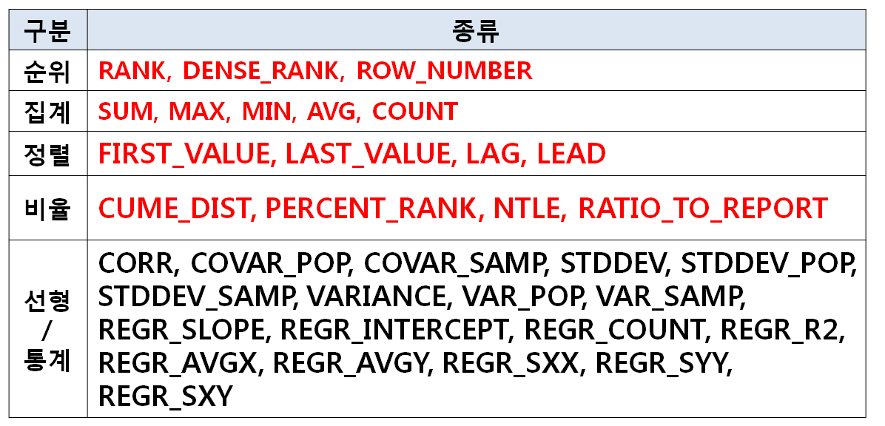
3. 분석 함수 (2/7)
분석 함수의 종류

Slide 36
3. 분석 함수 (3/7)
대표적인 분석 함수
- RANK : 특정칼럼에 대한 순위를 구함 (중복 허용)
RANK() OVER (PARTITION BY JOB_ID ORDER BY SALARY)
- DENSE_RANK : RANK함수와 비슷하나 순번이 다름
DENSE_RANK() OVER (ORDER BY SALARY DESC)
- ROW_NUMBER : 특정칼럼에 대한 순위를 구함 (중복 X)
ROW_NUMBER() OVER (ORDER BY SALARY DESC)
- 그룹 : 기존 그룹함수와 동일기능 (설명 생략)
- FIRST_VALUE(칼럼) : 처음에 나오는 값
FIRST_VALUE(SALARY) OVER (ORDER BY SALARY DESC)
- LAST_VALUE(칼럼) : 마지막에 나오는 값
LAST_VALUE(SALARY) OVER (ORDER BY SALARY DESC)
- LAG(칼럼) : 현재 로우의 바로 이전 로우의 값
LAG(SALARY) OVER (ORDER BY SALARY DESC)

Slide 37
3. 분석 함수 (4/7)
- LEAD(칼럼) : 현재 로우의 바로 이후 로우의 값
LEAD(SALARY) OVER (ORDER BY SALARY DESC)
- CUME_DIST() : 전체건수에서 현재행건수 비율 누적 값
최종적으로 마지막에 1이 된다
CUME_DIST() OVER (ORDER BY SALARY)
- PERCENT_RANK() : 행의 순서별 비율
제일 먼저 나오는것이 0, 마지막이 1 이다.
PERCENT_RANK() OVER (ORDER BY SALARY DESC)
- NTILE(숫자) : 전체건수를 숫자로 나누어 군별로 표시
전체건수를 나누어 1 부터 숫자로 표현된다.
NTILE(4) OVER (ORDER BY SALARY DESC)
- RATIO_TO_REPORT(칼럼) : 전체중 합계의 해당 비율
각각을 비율값을 합치면 1이 된다
RATIO_TO_REPORT(SALARY) OVER (PARTITION BY SALARY)

Slide 38
3. 분석 함수 (5/7)
선형 및 통계 분석 함수
- CORR(칼럼1, 칼럼2) : 상관 계수 반환
CORR(MIN_SALARY, MAX_SALARY) OVER (ORDER BY JOB_ID)
- COVAR_POP(칼럼1, 칼럼2) : 공분산을 반환
COVAR_POP(MIN_SALARY, MAX_SALARY)
OVER (ORDER BY JOB_ID)
- COVAR_SAMP(칼럼1, 칼럼2) : 공분산을 반환
COVAR_SAMP(MIN_SALARY, MAX_SALARY)
OVER (ORDER BY JOB_ID)
- STDDEV(칼럼) : 표준편차를 반환
STDDEV(MIN_SALARY) OVER (ORDER BY JOB_ID)
- STDDEV_POP(칼럼) : 모집단 표준편차를 계산하고
모집단 분산의 제곱근을 반환
STDDEV_POP(MIN_SALARY) OVER (ORDER BY JOB_ID)

Slide 39
3. 분석 함수 (6/7)
- STDDEV_SAMP(칼럼) : 누적 표준편차를 계산하고
표준분산의 제곱근을 반환
STDDEV_SAMP(MIN_SALARY) OVER (ORDER BY JOB_ID)
- VARIANCE(칼럼) : 분산을 반환
VARIANCE(MIN_SALARY) OVER (ORDER BY JOB_ID)
- VAR_POP(칼럼) : 숫자 집합의 모집단 분산을 반환
VAR_POP(MIN_SALARY) OVER (ORDER BY JOB_ID)
- VAR_SAMP(칼럼) : 숫자 집합의 표준 분산을 반환
VAR_SAMP(MIN_SALARY) OVER (ORDER BY JOB_ID)
- REGR_XXXX(파라미터) : 선형회기 함수
REGR_XXXX(MIN_SALARY) OVER (ORDER BY JOB_ID)

Slide 40
3. 분석 함수 (7/7)
OVER 문
PARTITION BY 절, ORDER BY 절, WINDOWING 절로 구성
- PARTITION BY 절
일반적인 SQL문에서 GROUP BY 절 의미와 동일
집계와 주로 많이 사용됨
SUM(SALARY) OVER (PARTITION BY JOB_ID)
- ORDER BY 절
일반적인 SQL문에서 ORDER BY 절 의미와 동일
순위와 정렬에서 주로 많이 사용됨
ROW_NUMBER () OVER (ORDER BY SALARY DESC)
- WINDOWING 절
분석함수의 대상이 되는 행의 기준 범위를 지정
ROWS 와 RANGE 둘중 하나 지정
ROWS:물리적 결과 행의 수, RANGE:논리적값의 범위

Slide 41
--분석함수를 이용한 방법
SELECT ROWNUM, ROW_CNT, EMPLOYEE_ID, FIRST_NAME, PHONE_NUMBER
FROM
(
SELECT EMPLOYEE_ID, FIRST_NAME, PHONE_NUMBER,
ROW_NUMBER() OVER(ORDER BY FIRST_NAME) AS ROW_CNT
FROM EMPLOYEES
)
WHERE ROW_CNT < 6;

Slide 42
SELECT ROWNUM, ROW_CNT, EMPLOYEE_ID, FIRST_NAME, PHONE_NUMBER
FROM
(
SELECT EMPLOYEE_ID, FIRST_NAME, PHONE_NUMBER,
ROW_NUMBER() OVER(ORDER BY FIRST_NAME) AS ROW_CNT
FROM EMPLOYEES
)
WHERE ROW_CNT BETWEEN 3 AND 9;

Slide 43
--분석함수
--순위
SELECT FIRST_NAME, JOB_ID, SALARY
, RANK() OVER (ORDER BY SALARY DESC) AS RANK
, DENSE_RANK() OVER (ORDER BY SALARY DESC) AS DENSE_RANK
, ROW_NUMBER() OVER (ORDER BY SALARY DESC) AS ROW_NUMBER
FROM EMPLOYEES
ORDER BY SALARY DESC; --역순

Slide 44
--그룹 안에서의 순위 (PARTITION BY)
SELECT FIRST_NAME, JOB_ID, SALARY,
RANK() OVER (PARTITION BY JOB_ID ORDER BY SALARY DESC) AS RANK,
DENSE_RANK() OVER (PARTITION BY JOB_ID ORDER BY SALARY DESC) AS DENSE_RANK,
ROW_NUMBER() OVER (PARTITION BY JOB_ID ORDER BY SALARY DESC) AS ROW_NUMBER
FROM EMPLOYEES
ORDER BY JOB_ID, SALARY DESC;

Slide 45
--집계
--전체
SELECT FIRST_NAME, JOB_ID, SALARY,
SUM(SALARY) OVER () AS TOT_SUM,
COUNT(*) OVER () AS TOT_CNT,
AVG(SALARY) OVER () AS TOT_AVG,
MAX(SALARY) OVER () AS TOT_MAX,
MIN(SALARY) OVER () AS TOT_MIN
FROM EMPLOYEES
ORDER BY JOB_ID, FIRST_NAME;

Slide 46
--그룹 안에서 집계
SELECT FIRST_NAME, JOB_ID, SALARY,
SUM(SALARY) OVER (PARTITION BY JOB_ID) PART_SAL,
COUNT(*) OVER (PARTITION BY JOB_ID) PART_CNT,
AVG(SALARY) OVER (PARTITION BY JOB_ID) PART_AVG,
MAX(SALARY) OVER (PARTITION BY JOB_ID) PART_MAX,
MIN(SALARY) OVER (PARTITION BY JOB_ID) PART_MIN
FROM EMPLOYEES
ORDER BY JOB_ID, FIRST_NAME;

Slide 47
--정렬
SELECT FIRST_NAME, JOB_ID, SALARY,
FIRST_VALUE(FIRST_NAME) OVER (ORDER BY FIRST_NAME) FIRST_SAL,
LAST_VALUE(FIRST_NAME) OVER (ORDER BY FIRST_NAME) LAST_SAL,
LAG(FIRST_NAME) OVER (ORDER BY FIRST_NAME) LAG_SAL,
LEAD(FIRST_NAME) OVER (ORDER BY FIRST_NAME) LEAD_SAL
FROM EMPLOYEES
ORDER BY FIRST_NAME;

Slide 48
--그룹 안에서
SELECT FIRST_NAME, JOB_ID, SALARY,
FIRST_VALUE(FIRST_NAME) OVER (PARTITION BY JOB_ID ORDER BY
FIRST_NAME) FIRST_SAL,
LAST_VALUE(FIRST_NAME) OVER (PARTITION BY JOB_ID ORDER BY
FIRST_NAME) LAST_SAL,
LAG(FIRST_NAME) OVER (PARTITION BY JOB_ID ORDER BY
FIRST_NAME) LAG_SAL,
LEAD(FIRST_NAME) OVER (PARTITION BY JOB_ID ORDER BY
FIRST_NAME) LEAD_SAL
FROM EMPLOYEES
ORDER BY JOB_ID, FIRST_NAME;

Slide 49
--비율
-- CUME_DIST() : 전체건수에서 현재 행 건수 비율 누적한 값으로 최종적으로 마지막에 1이 된다
-- PERCENT_RANK() : 행의 순서 별 비율 제일 먼저 나오는 것이 0, 마지막이 1 이다.
-- NTILE(숫자) : 전체건수를 숫자로 나누어 군별로 표시
-- 전체건수를 나누어 1 부터 숫자로 표현된다.
-- RATIO_TO_REPORT(칼럼) : 전체 중 합계의 해당 비율 각각을 비율 값을 합치면 1이 된다
SELECT FIRST_NAME, JOB_ID, SALARY,
CUME_DIST() OVER (ORDER BY FIRST_NAME) AS CUME_SAL,
PERCENT_RANK() OVER (ORDER BY FIRST_NAME) AS PERC_SAL,
NTILE(10) OVER (ORDER BY FIRST_NAME) AS NTILE_SAL,
RATIO_TO_REPORT(SALARY) OVER () AS RATIO_SAL
FROM EMPLOYEES
ORDER BY FIRST_NAME;

Slide 50
--그룹 안에서의 비율
SELECT FIRST_NAME, JOB_ID, SALARY,
CUME_DIST() OVER (PARTITION BY JOB_ID ORDER BY FIRST_NAME)
AS CUME_SAL,
PERCENT_RANK() OVER (PARTITION BY JOB_ID ORDER BY FIRST_NAME)
AS PERC_SAL,
NTILE(10) OVER (PARTITION BY JOB_ID ORDER BY FIRST_NAME)
AS NTILE_SAL,
RATIO_TO_REPORT(SALARY) OVER (PARTITION BY JOB_ID)
AS RATIO_SAL
FROM EMPLOYEES
ORDER BY FIRST_NAME;

Slide 51
--선형 및 통계 분석 함수
SELECT FIRST_NAME, JOB_ID, SALARY,
CORR(SYSDATE - HIRE_DATE, SALARY)
OVER (PARTITION BY JOB_ID) AS COR_SAL,
COVAR_POP(SYSDATE - HIRE_DATE, SALARY)
OVER (PARTITION BY JOB_ID) AS CORP_SAL,
COVAR_SAMP(SYSDATE - HIRE_DATE, SALARY)
OVER (PARTITION BY JOB_ID) AS CORS_SAL,
STDDEV(SALARY) OVER (ORDER BY HIRE_DATE) AS STD_SAL,
STDDEV_POP(SALARY) OVER (ORDER BY HIRE_DATE) AS STDP_SAL,
STDDEV_SAMP(SALARY) OVER (PARTITION BY JOB_ID) AS STDS_SAL,
VARIANCE(SALARY) OVER (PARTITION BY JOB_ID) AS VAR_SAL,
VAR_POP(SALARY) OVER (PARTITION BY JOB_ID) AS VARP_SAL,
VAR_SAMP(SALARY) OVER (PARTITION BY JOB_ID) AS VARS_SAL,

Slide 52
REGR_SLOPE(SYSDATE - HIRE_DATE, SALARY)
OVER (PARTITION BY JOB_ID) AS SLOPE_SAL,
REGR_INTERCEPT(SYSDATE - HIRE_DATE, SALARY)
OVER (PARTITION BY JOB_ID) AS INTCPT_SAL, REGR_COUNT(SYSDATE - HIRE_DATE, SALARY)
OVER (PARTITION BY JOB_ID) AS COUNT_SAL,
REGR_R2(SYSDATE - HIRE_DATE, SALARY)
OVER (PARTITION BY JOB_ID) AS R2_SAL,
REGR_AVGX(SYSDATE - HIRE_DATE, SALARY)
OVER (PARTITION BY JOB_ID) AS AVGX_SAL,
REGR_AVGY(SYSDATE - HIRE_DATE, SALARY)
OVER (PARTITION BY JOB_ID) AS AVGY_SAL,
REGR_SXX(SYSDATE - HIRE_DATE, SALARY)
OVER (PARTITION BY JOB_ID) AS SXX_SAL,

Slide 53
REGR_SYY(SYSDATE - HIRE_DATE, SALARY)
OVER (PARTITION BY JOB_ID) AS SYY_SAL,
REGR_SXY(SYSDATE - HIRE_DATE, SALARY)
OVER (PARTITION BY JOB_ID) AS SXY_SAL
FROM EMPLOYEES
ORDER BY JOB_ID, FIRST_NAME;

Slide 54
4. WINDOWING 절 (1/3)
분석함수의 대상이 되는 행 기준의 범위
ROWS(물리적 결과) 와 RANGE(논리적 범위) 로 사용
형태 1 : [ROWS or RANGE] <시작_단어>
형태 2 : [ROWS or RANGE] BETWEEN <시작_단어>
AND <종료_단어>
- 시작_단어 사용 가능
1.UNBOUNDED PRECEDING (미지정 이전 건)
2.CURRENT ROW (현재 건)
3.<SQL표현식> PRECEDING (이전) or FOLLOWING (이후)
※ BETWEEN 이 없는 경우 FOLLOWING 사용 못함
- 종료_단어
1.UNBOUNDED FOLLOWING (미지정 이후 건)
2.CURRENT ROW (현재 건)
3.<SQL표현식> PRECEDING (이전) or FOLLOWING (이후)

Slide 55
4. WINDOWING 절 (2/3)
ROWS [BETWEEN] – 정렬된 로우 기준
물리적 결과로 나온 로우(ROW)를 기준으로 표현
SELECT FIRST_NAME, JOB_ID, SALARY,
SUM(SALARY) OVER (ORDER BY FIRST_NAME ROWS
UNBOUNDED PRECEDING ) J_SAL_W1,
SUM(SALARY) OVER (ORDER BY FIRST_NAME ROWS
CURRENT ROW) J_SAL_W2,
SUM(SALARY) OVER (ORDER BY FIRST_NAME ROWS
3 PRECEDING) J_SAL_W3,
SUM(SALARY) OVER (ORDER BY FIRST_NAME
ROWS BETWEEN 1 FOLLOWING
AND 2 FOLLOWING) J_SAL_W4
FROM EMPLOYEES
ORDER BY FIRST_NAME;

Slide 56
4. WINDOWING 절 (3/3)
RANGE [BETWEEN] – 조회된 칼럼의 값을 기준으로 표현
칼럼의 값을 기준으로 값을 더하거나 빼서 계산
SELECT FIRST_NAME, JOB_ID, SALARY,
COUNT(*) OVER (ORDER BY SALARY RANGE
UNBOUNDED PRECEDING ) J_SAL_W1,
COUNT(*) OVER (ORDER BY SALARY RANGE
CURRENT ROW) J_SAL_W2,
COUNT(*) OVER (ORDER BY SALARY RANGE
3000 PRECEDING) J_SAL_W3,
COUNT(*) OVER (ORDER BY SALARY
RANGE BETWEEN 2000 PRECEDING
AND 3000 FOLLOWING) J_SAL_W4
FROM EMPLOYEES
ORDER BY SALARY;

Slide 57
--WINDOWING절
--정렬을 이용하여 이해하기 windowing절이 없을 때
SELECT FIRST_NAME, JOB_ID, SALARY,
FIRST_VALUE(FIRST_NAME) OVER (ORDER BY FIRST_NAME)
AS FIRST_SAL,
LAST_VALUE(FIRST_NAME) OVER (ORDER BY FIRST_NAME)
AS LAST_SAL,
LAG(FIRST_NAME) OVER (ORDER BY FIRST_NAME)
AS LAG_SAL,
LEAD(FIRST_NAME) OVER (ORDER BY FIRST_NAME)
AS LEAD_SAL
FROM EMPLOYEES
ORDER BY FIRST_NAME;

Slide 58
--ERROR 범위가 명확한 것은 windowing 절이 필요 없다.
SELECT FIRST_NAME, JOB_ID, SALARY,
FIRST_VALUE(FIRST_NAME) OVER (ORDER BY FIRST_NAME)
AS FIRST_SAL,
LAST_VALUE(FIRST_NAME) OVER (ORDER BY FIRST_NAME)
AS LAST_SAL,
LAG(FIRST_NAME) OVER (ORDER BY FIRST_NAME
ROWS UNBOUNDED PRECEDING)
AS LAG_SAL,
LEAD(FIRST_NAME) OVER (ORDER BY FIRST_NAME
ROWS UNBOUNDED PRECEDING)
AS LEAD_SAL
FROM EMPLOYEES
ORDER BY FIRST_NAME;

Slide 59
--ROWS로 물리적 범위를 지정
SELECT FIRST_NAME, JOB_ID, SALARY,
FIRST_VALUE(FIRST_NAME) OVER (ORDER BY FIRST_NAME
ROWS BETWEEN UNBOUNDED PRECEDING AND UNBOUNDED
FOLLOWING) AS UN_FIRST,
LAST_VALUE(FIRST_NAME) OVER (ORDER BY FIRST_NAME
ROWS BETWEEN UNBOUNDED PRECEDING AND UNBOUNDED
FOLLOWING) AS UN_LAST,
FIRST_VALUE(FIRST_NAME) OVER (ORDER BY FIRST_NAME
ROWS BETWEEN UNBOUNDED PRECEDING AND CURRENT ROW)
AS CUR_FIRST,
LAST_VALUE(FIRST_NAME) OVER (ORDER BY FIRST_NAME
ROWS BETWEEN UNBOUNDED PRECEDING AND CURRENT ROW)
AS CUR_LAST,

Slide 60
FIRST_VALUE(FIRST_NAME) OVER (ORDER BY FIRST_NAME
ROWS BETWEEN 3 PRECEDING AND 3 FOLLOWING)
AS FIX_FIRST,
LAST_VALUE(FIRST_NAME) OVER (ORDER BY FIRST_NAME
ROWS BETWEEN 3 PRECEDING AND 3 FOLLOWING)
AS FIX_LAST
FROM EMPLOYEES
ORDER BY FIRST_NAME;

Slide 61
--RANGE로 논리적 범위를 지정
--ERROR 문자형은 논리적 범위 지정으로 사용 못함
SELECT FIRST_NAME, JOB_ID, SALARY,
FIRST_VALUE(FIRST_NAME) OVER (ORDER BY FIRST_NAME
RANGE BETWEEN UNBOUNDED PRECEDING AND UNBOUNDED
FOLLOWING) AS UN_FIRST,
LAST_VALUE(FIRST_NAME) OVER (ORDER BY FIRST_NAME
RANGE BETWEEN UNBOUNDED PRECEDING AND UNBOUNDED
FOLLOWING) AS UN_LAST,
FIRST_VALUE(FIRST_NAME) OVER (ORDER BY FIRST_NAME
RANGE BETWEEN UNBOUNDED PRECEDING AND CURRENT ROW)
AS CUR_FIRST,
LAST_VALUE(FIRST_NAME) OVER (ORDER BY FIRST_NAME
RANGE BETWEEN UNBOUNDED PRECEDING AND CURRENT ROW)
AS CUR_LAST,

Slide 62
FIRST_VALUE(FIRST_NAME) OVER (ORDER BY FIRST_NAME
RANGE BETWEEN 3 PRECEDING AND 3 FOLLOWING) AS FIX_FIRST,
LAST_VALUE(FIRST_NAME) OVER (ORDER BY FIRST_NAME
RANGE BETWEEN 3 PRECEDING AND 3 FOLLOWING) AS FIX_LAST
FROM EMPLOYEES
ORDER BY FIRST_NAME;

Slide 63
-- 숫자 형의 자료여야 한다
SELECT FIRST_NAME, JOB_ID, SALARY,
ROW_NUMBER() OVER (ORDER BY SALARY) AS ROW_CNT,
COUNT(*) OVER (ORDER BY SALARY
RANGE BETWEEN UNBOUNDED PRECEDING AND UNBOUNDED
FOLLOWING) AS UN_SAL,
COUNT(*) OVER (ORDER BY SALARY
RANGE BETWEEN UNBOUNDED PRECEDING AND CURRENT ROW)
AS CUR_SAL,
COUNT(*) OVER (ORDER BY SALARY
RANGE BETWEEN 500 PRECEDING AND 500 FOLLOWING)
AS FIX_SAL
FROM EMPLOYEES
ORDER BY SALARY;

Slide 64
테이블의 결합(합집합, 차집합)
집합 연산자
합집합(UNION, UNION ALL)
교집합(INTERSECT)
차집합(MINUS)

Slide 65
1. 집합 연산자
집합 연산자
여러 개의 쿼리 결과를 한 개의 결과로 요약하는 연산자
SELECT문 [집합 연산자 SELECT문][집합연산자 SELECT문]
SELECT FIRST_NAME, SALARY
FROM EMPLOYEES
UNION ALL
SELECT JOB_TITLE, MIN_SALARY
FROM JOBS
※ 집합 연산자로 결과를 요약 하기 위해서는 각각의 쿼리의 결과의 칼럼의 수와 데이터타입이 동일 하여야 한다.
집합 연산자 종류
- 합집합 : UNION [ALL]
- 교집합 : INTERSECT
- 차집합 : MINUS

Slide 66
2. 합집합 (UNION, UNION ALL)
합집합 : A 집합 + B 집합
UNION ALL 연산자는 결과 값이 중복되어도 그대로 보여주는 반면 UNION 연산자는 중복되지 않게 보여준다.
SELECT *
FROM A
UNION
SELECT *
FROM B;
SELECT *
FROM A
UNION ALL
SELECT *
FROM B;
A 집합
B 집합
1, 2
3
4, 5
A 집합
B 집합
1, 2, 3
3, 4, 5

Slide 67
--집합연산자(합집합)
--UNION ALL
SELECT JOB_ID
FROM EMPLOYEES
WHERE JOB_ID IN ('AD_VP', 'FI_ACCOUNT')
UNION ALL
SELECT JOB_ID
FROM JOBS
WHERE JOB_ID IN ('AD_VP', 'FI_ACCOUNT');

Slide 68
3. 교집합 (INTERSECT)
교집합 : A 집합 와 B 집합 동시에 존재
INTERSECT 연산자는 각각의 쿼리에서 반환된 공통 결과를 중복되지 않게 보여준다.
SELECT *
FROM A
INTERSECT
SELECT *
FROM B;
※ JOIN으로 처리 가능 하다. (서브쿼리 이용도 가능)
공통된 결과인
3만 보여 주게된다
A 집합
B 집합
1, 2
3
4, 5

Slide 69
SELECT EMPLOYEE_ID
FROM EMPLOYEES
INTERSECT
SELECT MANAGER_ID
FROM DEPARTMENTS
SELECT DISTINCT A.EMPLOYEE_ID
FROM EMPLOYEES A, DEPARTMENTS B
WHERE A.EMPLOYEE_ID = B.MANAGER_ID

Slide 70
--집합연산자(교집합)
SELECT JOB_ID
FROM EMPLOYEES
INTERSECT -- 중복된 내용을 배제하고 보여준다
SELECT JOB_ID
FROM JOBS;

Slide 71
--JOIN으로 표현
SELECT DISTINCT A.JOB_ID
FROM EMPLOYEES A, JOBS B
WHERE A.JOB_ID = B.JOB_ID;
--서브쿼리로 표현
SELECT DISTINCT A.JOB_ID
FROM EMPLOYEES A
WHERE A.JOB_ID IN (SELECT B.JOB_ID FROM JOBS B);

Slide 72
4. 차집합 (MINUS)
차집합 : A 집합 에서 B 집합 목록을 제거
MINUS 연산자는 첫 번째 결과에서 두 번째 결과를 뺀 나머지 결과를 중복 되지 않게 보여준다
SELECT *
FROM A
MINUS
SELECT *
FROM B;
※ OUTER JOIN으로 처리 가능 하다.(서브쿼리 이용도 가능)
A에서 B에 중복된 3을 뺀
1, 2만 보여 주게 된다
A 집합
B 집합
1, 2
3
4, 5

Slide 73
SELECT EMPLOYEE_ID
FROM EMPLOYEES
MINUS
SELECT MANAGER_ID
FROM DEPARTMENTS
SELECT DISTINCT A.EMPLOYEE_ID
FROM EMPLOYEES A, DEPARTMENTS B
WHERE A.EMPLOYEE_ID = B.MANAGER_ID (+)
AND B.MANAGER_ID IS NULL

Slide 74
--집합연산자(차집합)
SELECT JOB_ID
FROM EMPLOYEES
MINUS
SELECT JOB_ID
FROM JOBS; -- 차이가 없으므로 아무 것도 출력되지 않는다
--차이가 있는 것으로 하면, EMPLOYEE_ID, MANAGER_ID
SELECT EMPLOYEE_ID
FROM EMPLOYEES
MINUS
SELECT MANAGER_ID
FROM EMPLOYEES;

Slide 75
--OUTER JOIN으로 표현
SELECT DISTINCT A.EMPLOYEE_ID
FROM EMPLOYEES A, EMPLOYEES B
WHERE A.EMPLOYEE_ID=B.MANAGER_ID (+) -- 여기까지 Outer Join
AND B.EMPLOYEE_ID IS NULL -- B 안에 있는 요소를 빼준다
ORDER BY A.EMPLOYEE_ID;

Slide 76
--서브쿼리로 표현
SELECT DISTINCT A.EMPLOYEE_ID
FROM EMPLOYEES A
WHERE A.EMPLOYEE_ID NOT IN (SELECT B.MANAGER_ID FROM EMPLOYEES B);
-- NOT IN으로는 아무 것도 나오지 않게 된다 그러므로
--NOT EXISTS로 표현해야 한다
SELECT DISTINCT A.EMPLOYEE_ID
FROM EMPLOYEES A
WHERE NOT EXISTS (SELECT 1
FROM EMPLOYEES B
WHERE A.EMPLOYEE_ID = B.MANAGER_ID);

Slide 77
- 정리 (1/2)
SELECT
SELECT 칼럼, [그룹함수]
FROM 테이블
WHERE 조건
[GROUP BY 그룹핑 목록]
[HAVING 그룹함수 조건]
[ORDER BY 정렬 목록]
[START WITH 계층쿼리 조건]
[CONNECT BY 계층쿼리 연계 조건]
JOIN (ANSI JOIN 과 ORACLE JOIN)
SELECT 칼럼 목록
FROM 테이블 목록
WHERE 테이블 연계 조건

Slide 78
- 정리 (2/2)
서브 쿼리
서브쿼리 ()형식으로 사용되며 단일행 서브쿼리
(SELECT절에서 사용되는 서브쿼리)조건에 주의 한다.
- 단일행 서브 쿼리가 되는 조건
1. 단일 그룹함수를 사용한 경우
2. 조건으로 PK(Primary Key)를 지정한 경우
3. ROWNUM = 1 이라는 조건의 지정
특수 쿼리
흐름제어문 : CASE문, DECODE문, NVL2문
TOP N 쿼리 : OFFSET X ROWS FETCH NEXT X ROWS ONLY(12c)
ROWNUM을 이용하는 방법
분석함수를 이용하는 방법

Slide 79
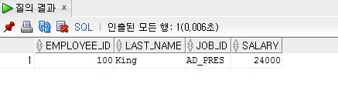
문제1) EMPLOYEES 테이블에서 Kochhar의 급여보다 많은 사원의 정보를 사원번호,이름,담당업무,급여를 출력하라.
SELECT EMPLOYEE_ID, LAST_NAME, JOB_ID, SALARY
FROM EMPLOYEES
WHERE SALARY >
(SELECT SALARY FROM EMPLOYEES WHERE LAST_NAME = 'Kochhar');

Slide 80
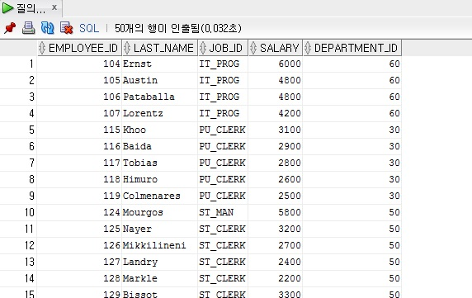
문제2) EMPLOYEES 테이블에서 급여의 평균보다 적은 사원의 정보를 사원번호,이름,담당업무,급여,부서번호를 출력하여라.
SELECT EMPLOYEE_ID,LAST_NAME,JOB_ID,SALARY,DEPARTMENT_ID
FROM EMPLOYEES
WHERE SALARY < (SELECT AVG(SALARY)FROM EMPLOYEES);

Slide 81
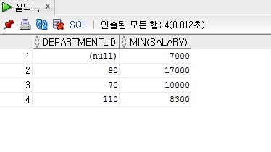
문제3) EMPLOYEES 테이블에서 100번 부서의 최소 급여보다 많은 모든 부서를 출력하라
SELECT DEPARTMENT_ID,MIN(SALARY)
FROM EMPLOYEES
GROUP BY DEPARTMENT_ID
HAVING MIN(SALARY) > (SELECT MIN(SALARY)
FROM EMPLOYEES
WHERE DEPARTMENT_ID = 100);

Slide 82
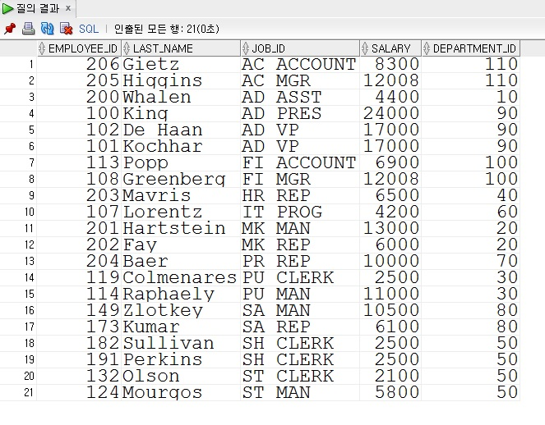
문제4) 업무별로 최소 급여를 받는 사원의 정보를 사원번호,이름,업무,부서번호를 출력하여라. 단 업무별로 정렬하여라.
SELECT EMPLOYEE_ID,LAST_NAME,JOB_ID,SALARY,DEPARTMENT_ID
FROM EMPLOYEES
WHERE (JOB_ID, SALARY) IN (SELECT JOB_ID, MIN(SALARY)
FROM EMPLOYEES
GROUP BY JOB_ID)
ORDER BY JOB_ID;

Slide 83
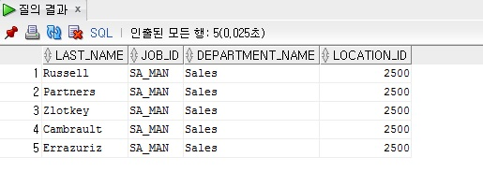
문제5) EMPLOYEES 과 DEPARTMENTS 테이블에서 업무가 세일드인 사원의 정보를 이름,업무,부서명,근무지를 출력하라.
SELECT e.LAST_NAME,e.JOB_ID,d.DEPARTMENT_NAME,d.LOCATION_ID
FROM (SELECT LAST_NAME, JOB_ID, DEPARTMENT_ID
FROM EMPLOYEES
WHERE JOB_ID = 'SA_MAN') e, DEPARTMENTS d
WHERE e.DEPARTMENT_ID = d.DEPARTMENT_ID;

Slide 84
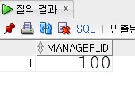
문제6) EMP 테이블에서 가장 많은 사원을 갖는 MANAGER의 사원번호를
출력하라.
SELECT MANAGER_ID
FROM EMPLOYEES
GROUP BY MANAGER_ID
HAVING COUNT(MANAGER_ID)
= (SELECT MAX(COUNT(*)) FROM EMPLOYEES GROUP BY MANAGER_ID);

Slide 85
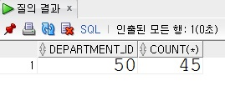
문제7) EMP 테이블에서 가장 많은 사원이 속해있는 부서번호와 사원수를
출력하라.
SELECT DEPARTMENT_ID, COUNT(*)
FROM EMPLOYEES
GROUP BY DEPARTMENT_ID
HAVING COUNT(DEPARTMENT_ID) =
(SELECT MAX(COUNT(*))
FROM EMPLOYEES
GROUP BY DEPARTMENT_ID);

Slide 86
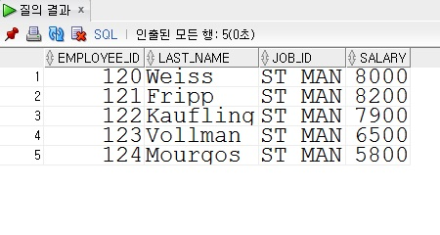
문제8) EMP 테이블에서 사원번호가 123인 사원의 직업과 같고
사원번호가 192인 사원의 급여(SAL)보다 많은 사원의 사원번호, 이름,
직업, 급여를 출력하라.
SELECT EMPLOYEE_ID, LAST_NAME, JOB_ID, SALARY
FROM EMPLOYEES
WHERE JOB_ID = (SELECT JOB_ID FROM EMPLOYEES WHERE EMPLOYEE_ID = 123)
AND SALARY > (SELECT SALARY FROM EMPLOYEES WHERE EMPLOYEE_ID = 192);

Slide 87
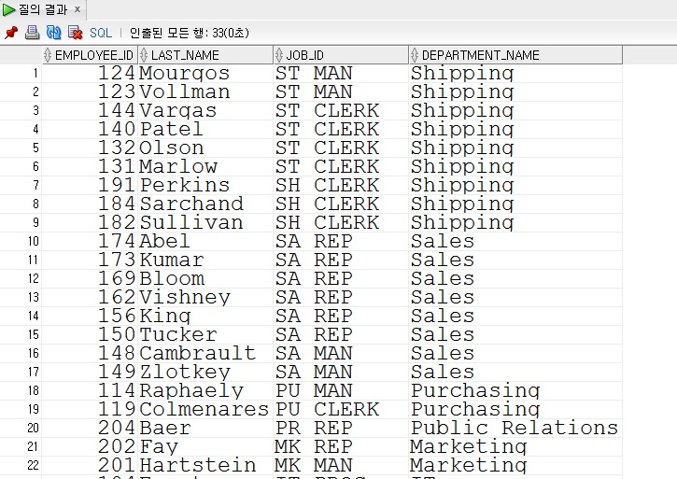
문제9) 직업(JOB)별로 최소 급여와 같은 급여를 받는 사원의 정보를 사원번호, 이름, 업무, 부서명을 출력하라.
-- 조건1 : 직업별로 내림차순 정렬
SELECT E.EMPLOYEE_ID, E.LAST_NAME, E.JOB_ID, D.DEPARTMENT_NAME
FROM EMPLOYEES E, DEPARTMENTS D
WHERE E.DEPARTMENT_ID = D.DEPARTMENT_ID
AND SALARY IN (SELECT MIN(SALARY) FROM EMPLOYEES
GROUP BY JOB_ID)
ORDER BY JOB_ID DESC;

Slide 88
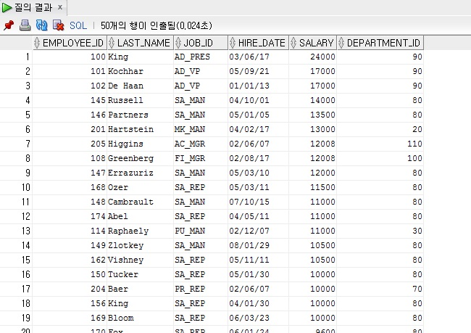
문제10) EMPLOYEES 테이블에서 50번 부서의 최소 급여를 받는 사원 보다 많은 급여를 받는 사원의 정보를 사원번호,이름,업무,입사일자,급여,부서번호를 출력하라. 단 50번은 제외
SELECT EMPLOYEE_ID,LAST_NAME,JOB_ID,HIRE_DATE,SALARY,
DEPARTMENT_ID
FROM EMPLOYEES
WHERE DEPARTMENT_ID != 50 AND SALARY > (SELECT MIN(SALARY)
FROM EMPLOYEES
WHERE DEPARTMENT_ID = 50);

Slide 89
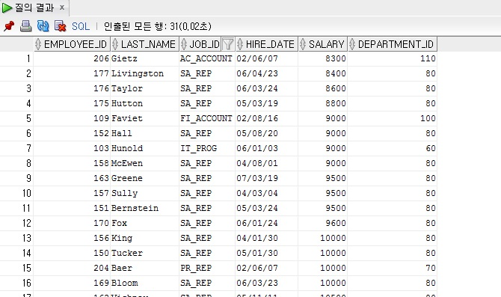
문제11) EMPLOYEES 테이블에서 50번 부서의 최고 급여를 받는 사원 보다
많은 급여를 받는 사원의 정보를 사원번호,이름,업무,입사일자,급여,부서번호를
출력하라. 단50번은 제외
SELECT EMPLOYEE_ID,LAST_NAME,JOB_ID,HIRE_DATE,SALARY,
DEPARTMENT_ID
FROM EMPLOYEES
WHERE DEPARTMENT_ID != 50 AND SALARY > (SELECT MAX(SALARY)
FROM EMPLOYEES
WHERE DEPARTMENT_ID = 50);

